Slide 1
Software Engineering CS 487
Dennis Hood
Computer Science
Summer ‘19
Notes:
This template can be used as a starter file for presenting training materials in a group setting.
Sections
Right-click on a slide to add sections. Sections can help to organize your slides or facilitate collaboration between multiple authors.
Notes
Use the Notes section for delivery notes or to provide additional details for the audience. View these notes in Presentation View during your presentation.
Keep in mind the font size (important for accessibility, visibility, videotaping, and online production)
Coordinated colors
Pay particular attention to the graphs, charts, and text boxes.
Consider that attendees will print in black and white or grayscale. Run a test print to make sure your colors work when printed in pure black and white and grayscale.
Graphics, tables, and graphs
Keep it simple: If possible, use consistent, non-distracting styles and colors.
Label all graphs and tables.

Slide 2
Lesson Overview
Design: Modeling and Architecture
Reading
Ch. 5 - System Modeling
Ch. 6 - Architectural Design
Ch. 7 – Design and Implementation
Objectives
Explore the design phase
Understand the role of modeling in creating systems – a picture says a thousand words
Examine State-Transition Diagrams which can be used to model system behavior and plan the interface to the user
Discuss the concept of architecture in the context of software systems
Examine architectures to meet the demands of various structural challenges
Analyze the concept of design “patterns” – common solutions to common problems

Slide 3

Lecture 5
Modeling and Architecture
Notes:
This is another option for an Overview slides using transitions.

Slide 4
Design Patterns
Adopted from the (building) architecture community
Common solutions to common problems
“Why reinvent the wheel?”
Similar benefits as in component reuse
Already proven, already tested
Significant up-front time savings,
even greater potential benefit by avoiding the fix-retest cycle

Slide 5
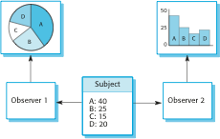
Ex. Observer Pattern
Separate the display of an object’s state from the object itself

Slide 6
From Design to Implementation
Reuse
Abstract reuse via design patterns
Object-oriented design and development
Reusable components
Reusable systems (tailored COTS)
Configuration management
Version control
System build management
Issue management
Host-target development
Configure development host to match target
Simulate target for testing

Slide 7
Architecture
Levels of abstraction
Program-level architecture (“small”)
System- or enterprise-level (“large”)
Designing the building
Solid foundation
Structure that meets basic needs
Support for aesthetic elements
Additional benefits of defined architecture
Means of communicating with stakeholders
Helps to complete the analysis
Facilitates large-scale reuse

Slide 8
Requirements Satisfaction
Non-functional system requirements are largely met through architecture design
Performance optimization
Security
Safety
Availability
Maintainability
Trade-offs are likely necessary due to conflicting priorities and/or overlaps in design elements

Slide 9
Design Decisions
Can an existing generic application architecture be reused?
How will the system be distributed across multiple processors?
What are the appropriate architectural styles or patterns?
How will structural elements be decomposed into modules?
What is the strategy for controlling the operation of system units?
How will the architecture be evaluated?, documented?

Slide 10
Architectural Views
Multiple perspectives help bring complex into focus
Logical – the system as interacting objects
Process – interacting processes
Development – components to be developed
Physical – interacting hardware and software
Conceptual – the basis for decomposing high-level requirements

Slide 11
Architectural Patterns
Layered architecture
Achieve separation and independence through layering
Hierarchical organization
Supports incremental development
Repository architecture
Support the exchange of information between sub-systems
Use a central repository to manage shared data
Establish and maintain a separate database for each sub-system
Client-server architecture
Organized as a set of services and associated servers, accessed by clients “calling” the services
Pipe-and-Filter architecture
Workflow
Information is transformed as it flows through the system

Slide 12
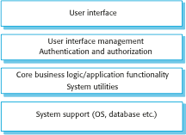
Generic Layered Architecture

Slide 13
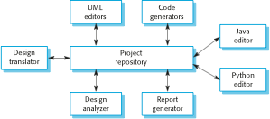
Ex. Repository Architecture

Slide 14
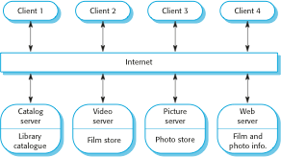
Ex. Client-Server Architecture

Slide 15
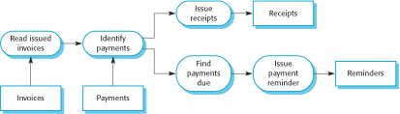
Ex. Pipe-and-Filter Architecture

Slide 16
Application Architectures
Alternatives to system architectures that focus on the needs of the application
Data-processing applications
Transaction-processing applications
Event-processing systems
Language-processing systems

Slide 17
Modular Decomposition Styles
Deciding how best to decompose sub-systems down to modules
Object-oriented decomposition
Loosely coupled objects with well-defined interfaces
Classes are templates with attributes and operations
During execution, objects are instantiated from classes
Function-oriented pipelining
Data flow
Inputs are processed by transformational functions to produce outputs
The “real” world looks more like objects
Therefore, OO works best for reuse
However, work looks more like functions
Therefore, FO provides the best immediate fit

Slide 18
Control Styles
Deciding how best to control modules in operation
Centralized control
Design a sub-system whose primary function is to control the other sub-systems
The vast majority of control is handled by this sub-system
Event-based control
Design each sub-system to “react” to events
Events can come from other sub-systems or the environment
Centralizing provides a single-point of design, implementation, etc. system focus
De-centralizing will often be a more logical fit for modeling the “real” world

Slide 19
Designing Distributed Systems
Spreading the processing load across multiple machines
Benefits
Shared and therefore better utilized resources
Open and therefore more standard-driven systems
Concurrency
Scalability
Fault tolerance
Disadvantages
Complexity
Vulnerable to security breaches
Difficult to manage
Unpredictability

Slide 20
Types of Distributed Systems
Multiprocessor architectures
The operating system can distribute the processes of a software system across multiple processors
The processes must be capable of running independent of each other
Client-server architectures
A centralized server system “offers” services to
de-centralized client processes
Thin-client systems are designed such that all but the presentation is housed at the server
Fat-client systems are designed such that all but the data management is housed at the clients

Slide 21
Client-Server Architecture

Slide 22
3-tier C/S Architecture

Slide 23
Distributed Object Architectures
Less restrictive than client-server in that all objects can offer services to all other objects
Middleware, known as an object request broker, allow distributed objects to communicate across networked computers

Slide 24
Distributed Object Architecture

Slide 25
Distributed Systems Patterns
Master-slave architecture
Real-time systems requiring guaranteed response times
2-tier client-server architecture
Centralized systems for security reasons
Multi-tier C/S architecture
To support high-volume transaction processing
Distributed component architecture
Supports combining resources from different systems
Peer-to-peer architecture
Servers “introduce” peers who then work together locally

Slide 26
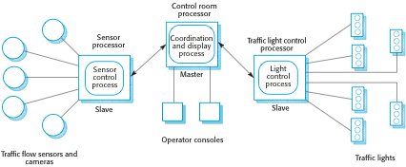
Ex. Master-Slave

Slide 27
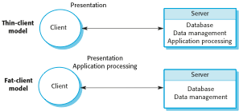
Ex. 2-tier Client-Server

Slide 28
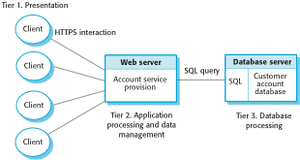
Ex. Multi-tier C/S

Slide 29
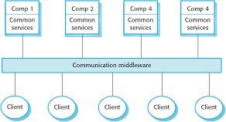
Ex. Distributed Component

Slide 30
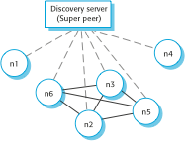
Ex. Peer-to-Peer

